Slide 1

IST 652 SCRIPTING FOR DATA ANALYSIS
NEW YORK CITY HOUSING MARKET ANALYSIS
GROUP 5
PRIYA RAUNIYAR
VABHAV SAGVEKAR
JASWANTH CHANDU

Slide 2
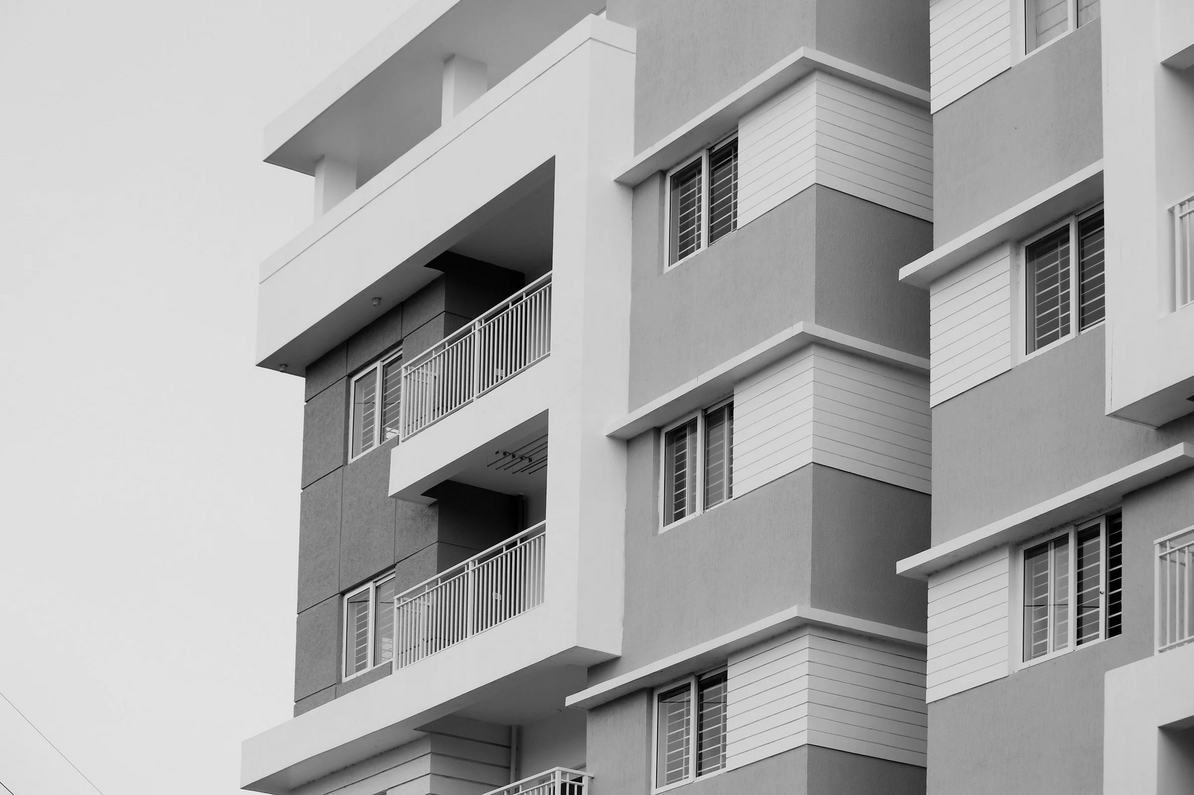
TABLE OF CONTENT
Project Overview
Methodology & Tools
Key Findings
Conclusions & Value of Insights

Slide 3


PROJECT OVERVIEW
Unit of Analysis:
Individual residential property listings
Data Sources & Types:
NYC Housing Dataset — Structured CSV
MTA Subway Stations — Structured CSV
NYC Borough Crime Stats — Semi-structured JSON / Structured CSV
Objective:
Analyze price determinants
Evaluate borough differences
Examine transit & crime influence
Segment the market using clustering
Caveats:
Crime data is borough-level only
Housing prices highly skewed → log transform
Inconsistent address fields (Queens locality issue)
Transit radius approximation (800m straight-line

Slide 4

METHODOLOGY TOOLS
Steps Performed
Packages Used (Why?)
Advanced Packages Implemented
Data Cleaning & Standardization
Borough Derivation (county → locality → fallback)
Transit Accessibility (haversine distance)
Crime Merge (borough-level)
EDA: scatterplots, boxplots, histograms, heatmaps
ANOVA for borough differences
Predictive Modeling (OLS + log-price OLS)
pandas — data manipulation
numpy — numeric computation
statsmodels — regression, ANOVA, diagnostics
statsmodels (OLS regression)

Slide 5

KEY FINDINGS
Price Determinants
Sqft & Baths = strongest predictors
Borough extremely influential
Transit access = mild positive effect (~3–4%)
Beds modest effect
Transit & Crime
Transit influence clear only after controlling for borough
Borough-level crime does not lower price (confounding effect)
Borough Differences
Manhattan = highest prices
Bronx / Staten Island = best affordability
Queens varies heavily by locality

Slide 6

CONCLUSIONS & VALUE OF INSIGHTS
What We Learned ??
Log-price model explains ~63% of variation
Borough & property size dominate price dynamics
Subway access adds modest value
Borough-level crime not reliable for pricing
Applications
For Investors: Identify undervalued neighborhoods with PPSF
For Homebuyers: Compare PPSF across neighborhoods
For City Planners: Identify transit deserts; need finer crime granularity
For Analysts: Use log-price + clustering for predictive insights

Slide 7
ANY QUESTIONS
THANK YOU

